Slide 1

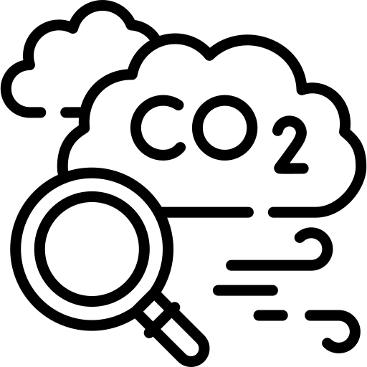

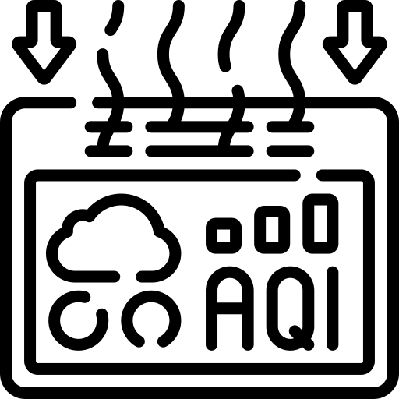

ML Project on Air Quality & Health Risk Predictor

Slide 2
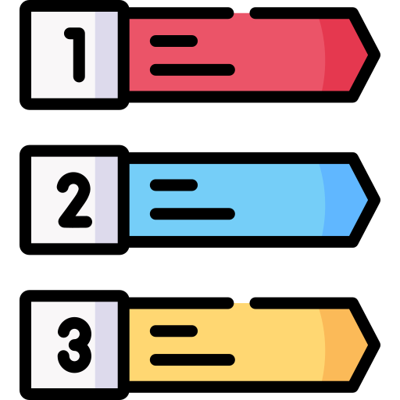
Index
ML Workflow
Business Understanding
Problem Statement
Data Collection
Data Exploration
Data Cleaning
Exploratory Data Analysis
Data Pre-processing
Model Building
Model Evaluation
Model Deployment

Slide 3







Tools Used

Slide 4
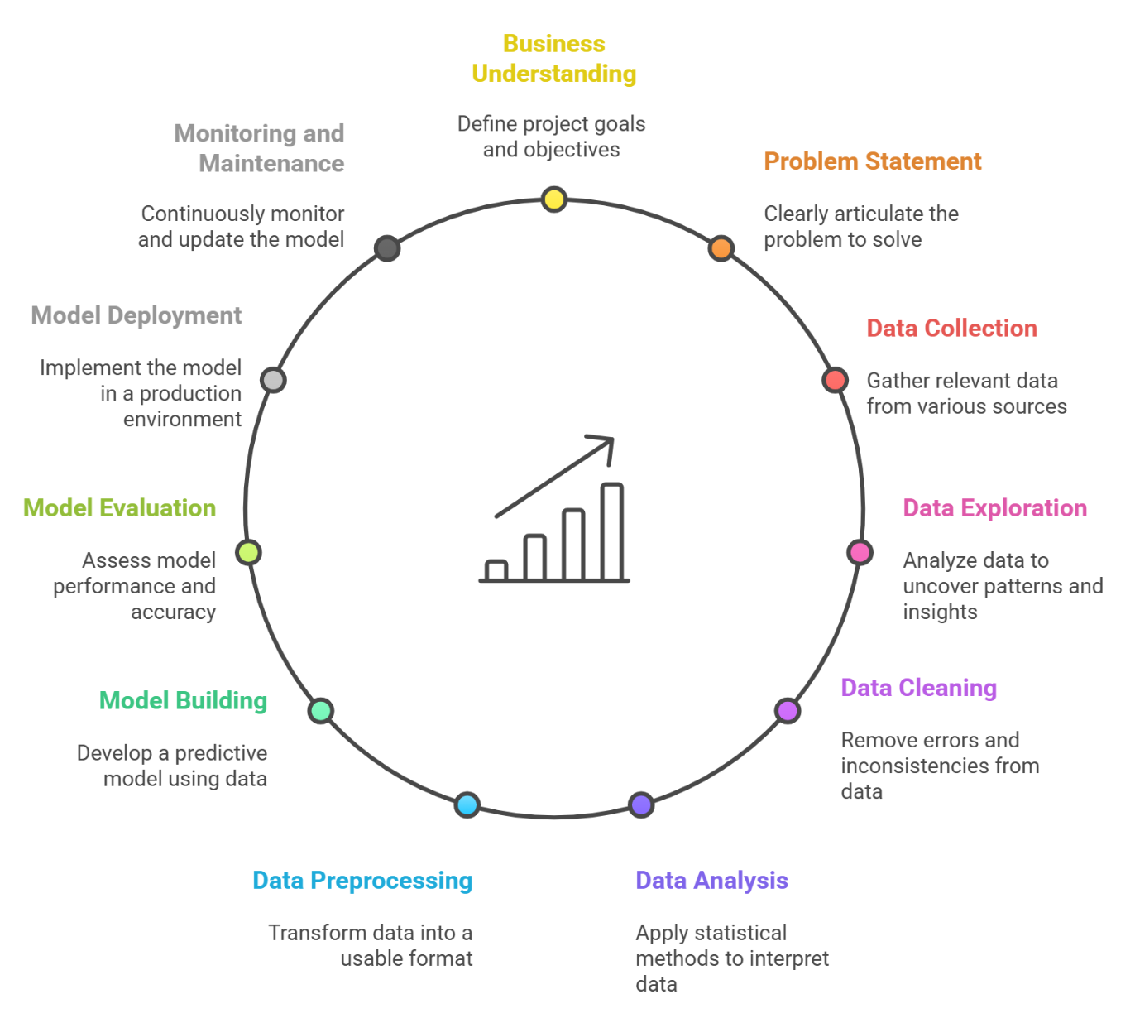
ML Workflow

Slide 5



Business Understanding
Air pollution is a major global health concern, especially in urban areas with traffic and industrial emissions. Exposure to pollutants like PM2.5, PM10, NO₂, SO₂, and O₃ leads to respiratory and cardiovascular diseases, making reliable air quality predictions essential.
Predicts future AQI values for different cities/regions.
Categorizes air quality into standard risk levels (Good to Severe).
Assesses health risks for sensitive groups and the general population.
Provides early warnings to reduce exposure during hazardous periods.
Supports policymakers in designing effective interventions.
Helps businesses optimize operations while ensuring worker safety.

Slide 6

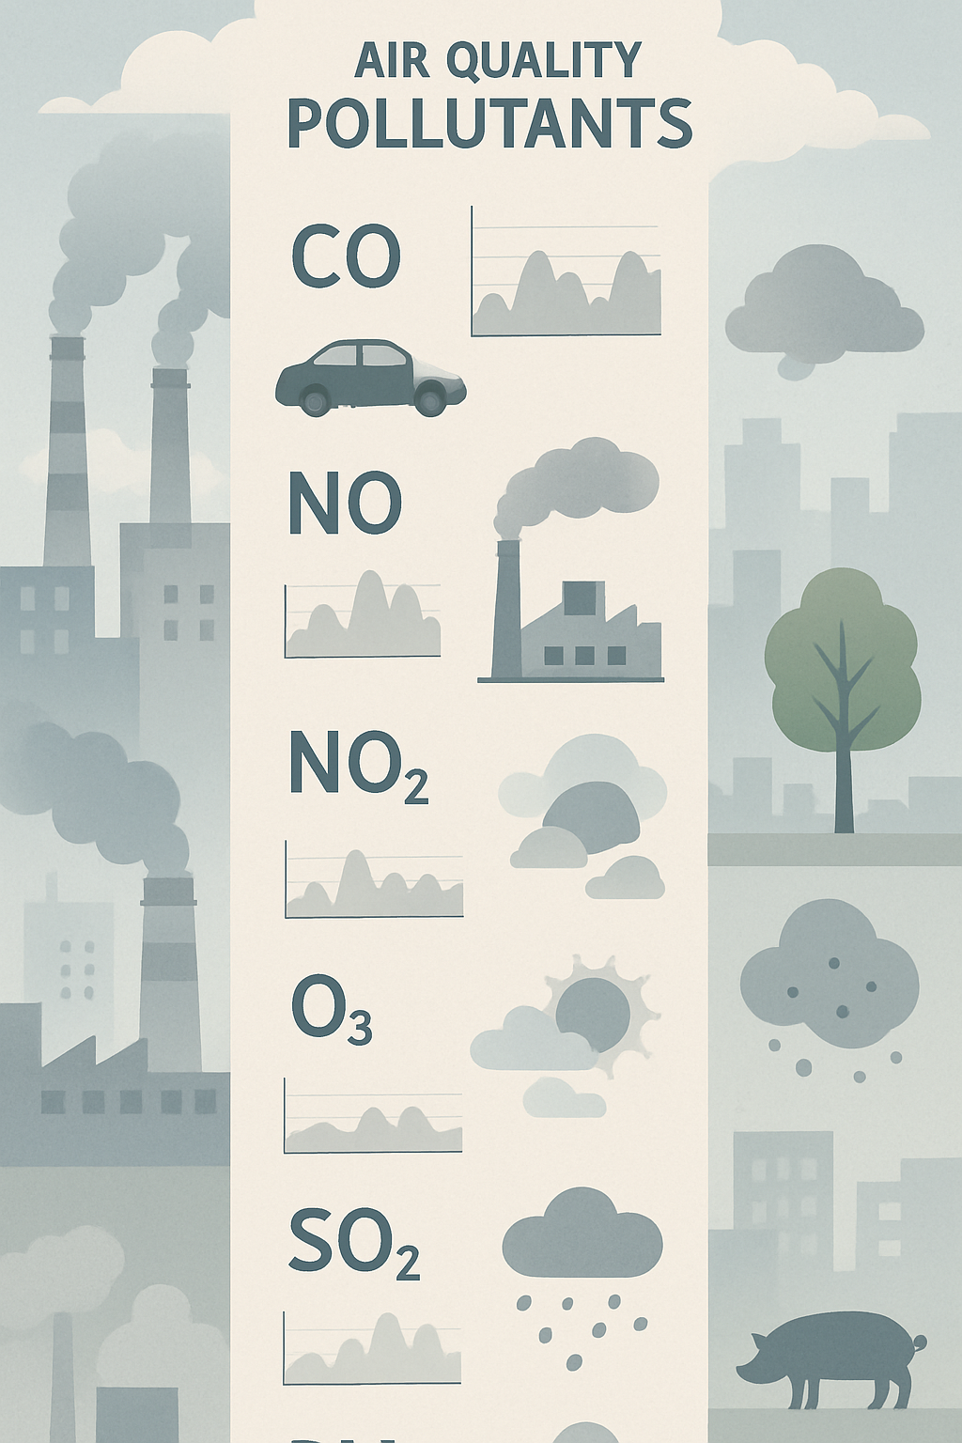
Problem Statement
Air pollution has become a critical environmental challenge, directly impacting public health and quality of life. The objective of this project is to analyze air quality data across various Indian states and cities, identify key pollutants influencing the Air Quality Index (AQI), and build machine learning model to classify and predict AQI levels. By leveraging data preprocessing, and predictive modeling, this study aims to provide actionable insights into pollution patterns and support decision-making for effective air quality management.

Slide 7

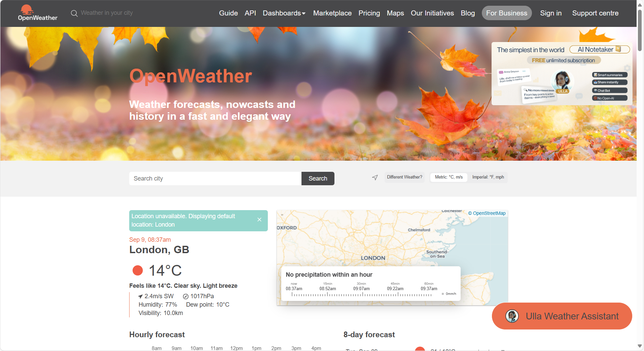
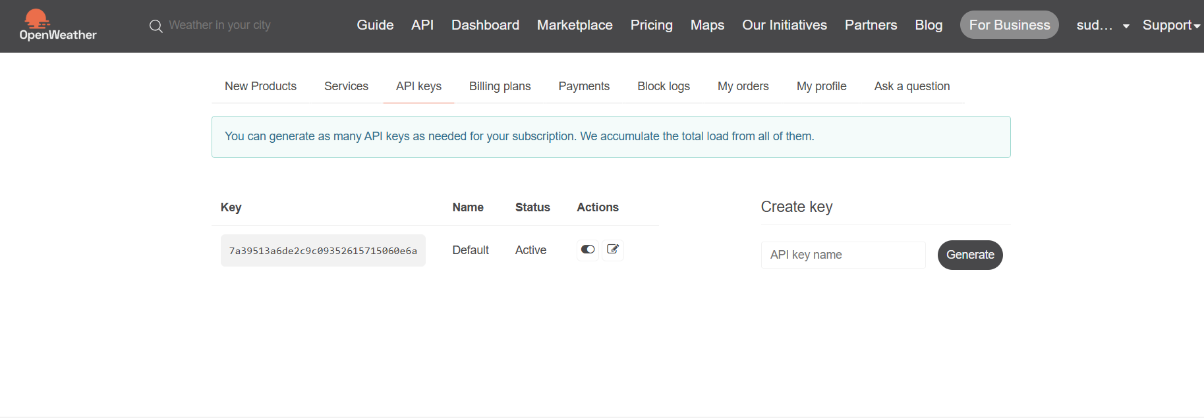
Data Collection
01
Identified reliable APIs for air quality & weather data
Connected using Python (requests) with parameters (city, state, date)
Extracted data in JSON format (pollutants, AQI, weather features)

Slide 8
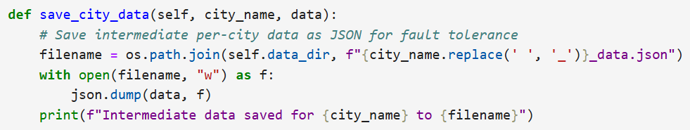
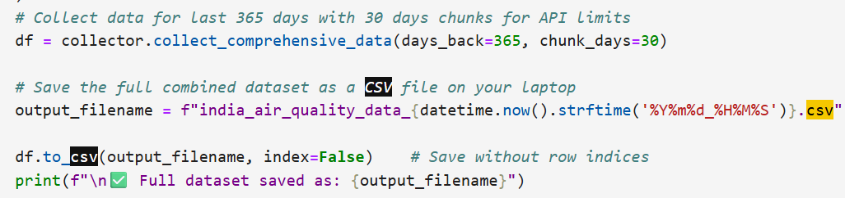
02
Transformed JSON into structured Pandas DataFrame
Stored data in CSV for analysis
Validated data (missing values, consistency checks)
Automated with schedulers for continuous updates

Slide 9


Data Exploration

Slide 10

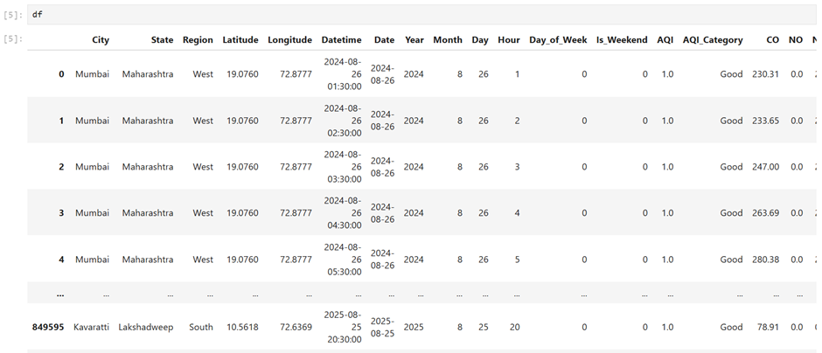
Raw Data Overview
Loaded Dataset: Imported the air quality dataset (india_air_quality_data.csv) into a Pandas DataFrame.

Slide 11

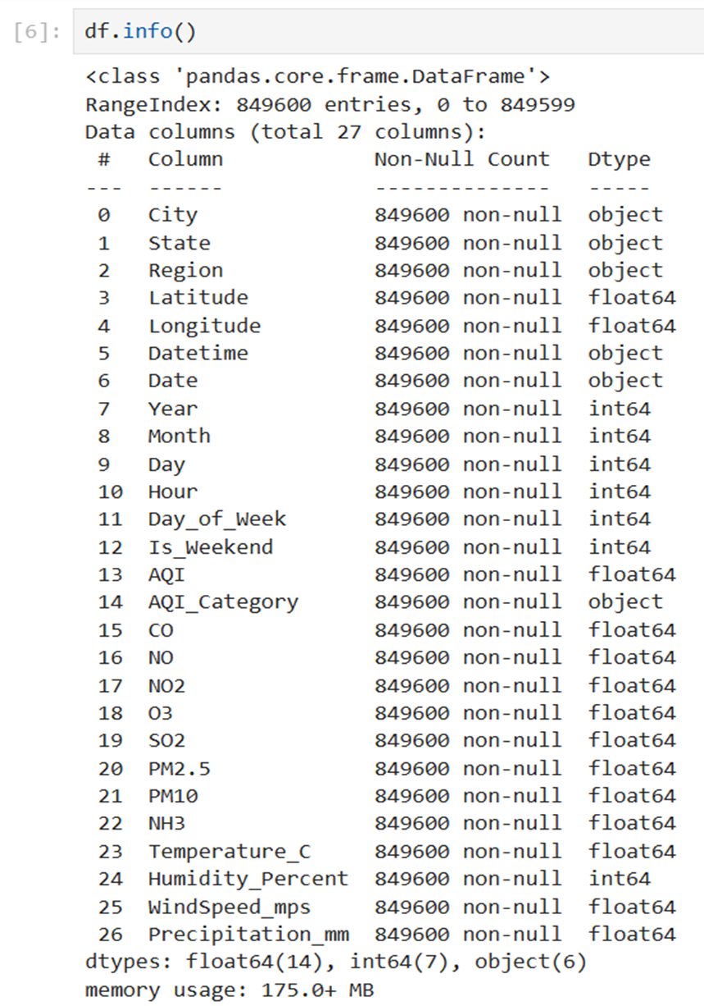
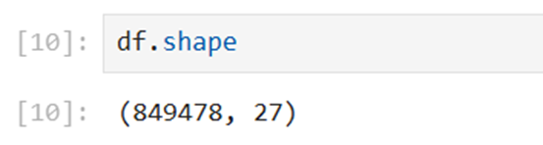
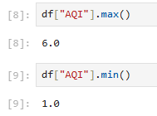
Features Extracted
Total Columns: 27
Checked dataset shape (rows × columns).

Slide 12


Data Cleaning

Slide 13
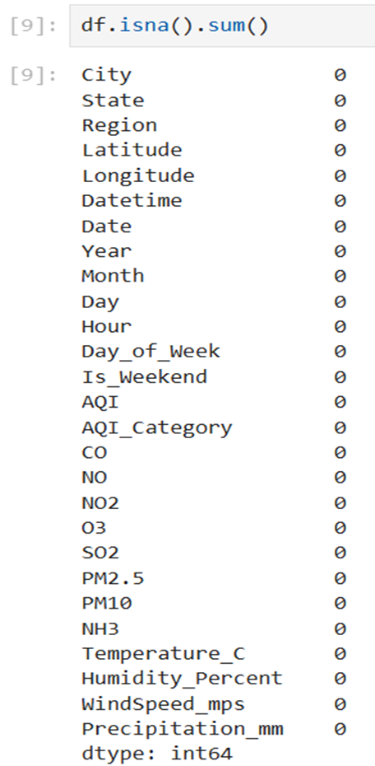
01
Handling Unknown/Invalid Values:
Removed rows where AQI_Category was
labeled as "Unknown".
02
Missing Value Treatment:
Identified missing values using .isna().sum().
Considered strategies like removal, imputation, or interpolation depending on feature importance.
03
Data Consistency Checks:
Ensured categorical labels (e.g., AQI categories) were standardized.
Verified pollutant ranges were within realistic limits.

Slide 14
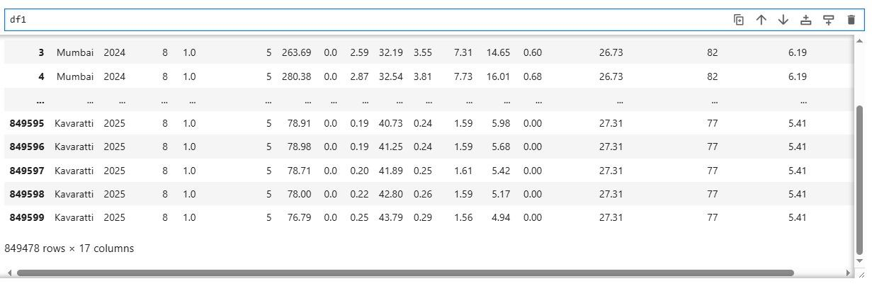
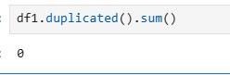
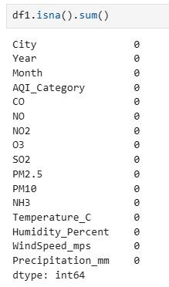
Cleaned Data:

Slide 15


Exploratory Data Analysis

Slide 16

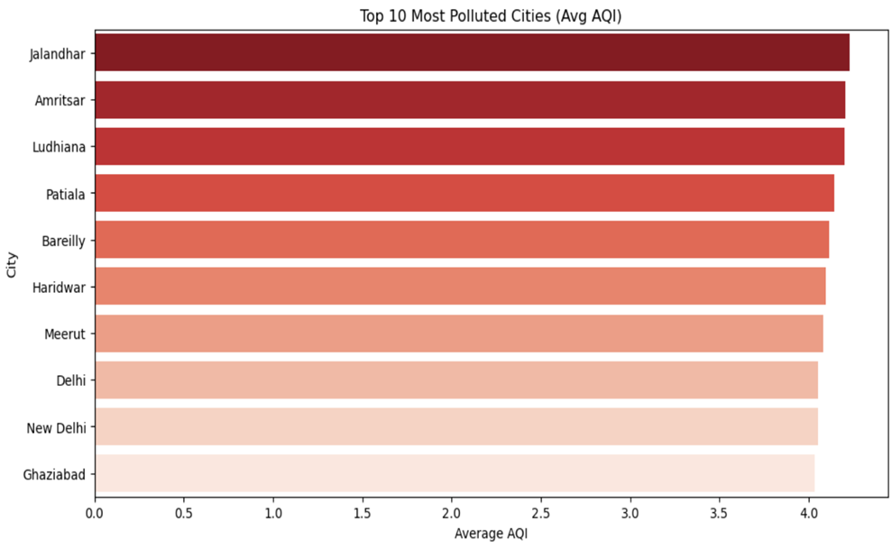
Top 10 Most Polluted Cities
This visualization shows that cities in Punjab, Uttar Pradesh, and Delhi NCR (like Jalandhar, Amritsar, Ludhiana, and Delhi) have the highest average AQI, indicating severe air pollution and health risks.

Slide 17
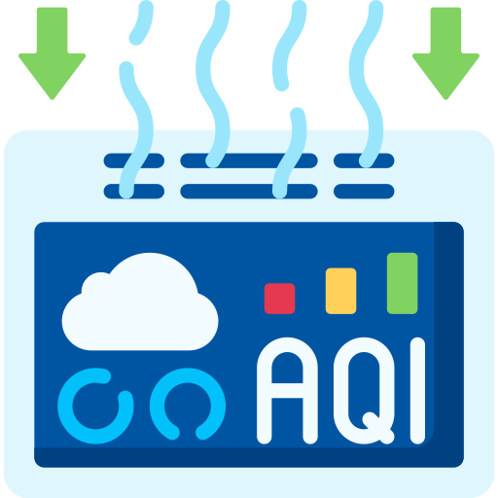
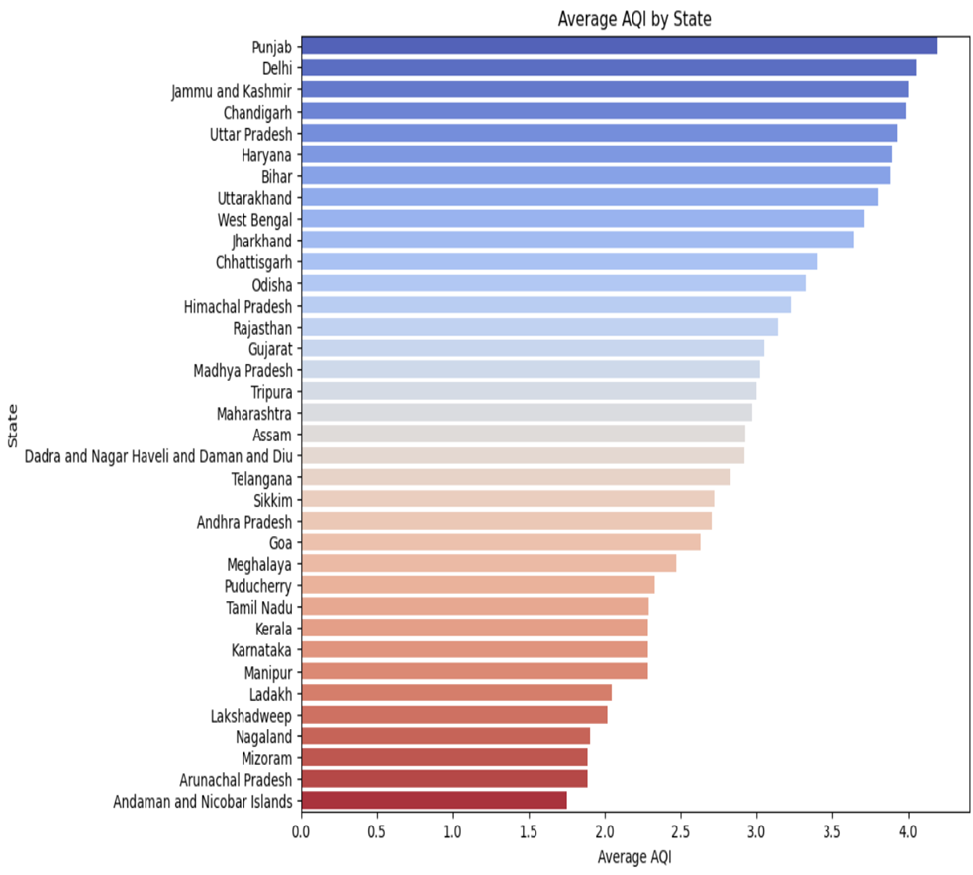
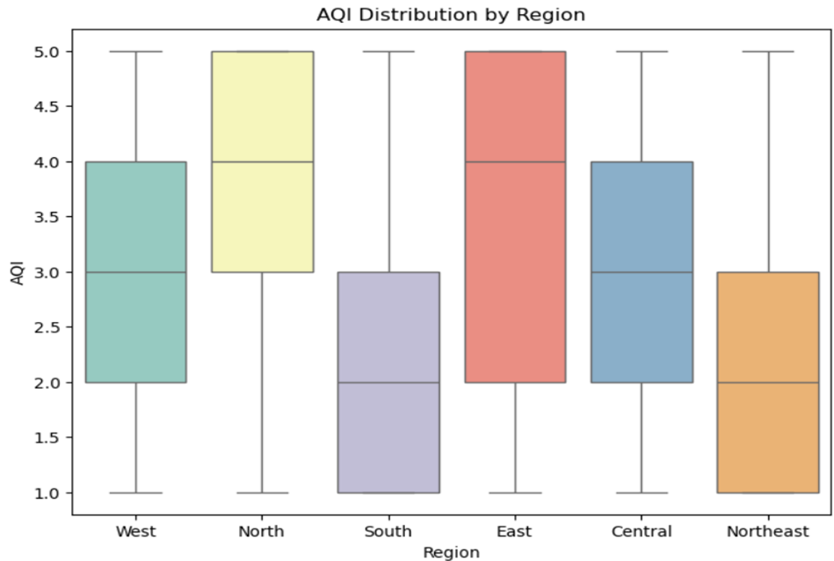
AQI Trends Across Indian States and Regions
Punjab (4.2) and Delhi (4.1) show the worst air quality, while Andaman & Nicobar (1.7) and Mizoram (1.8) have the cleanest air.
North and East regions face the highest AQI (~4), while South and Northeast enjoy lower AQI (~2).

Slide 18
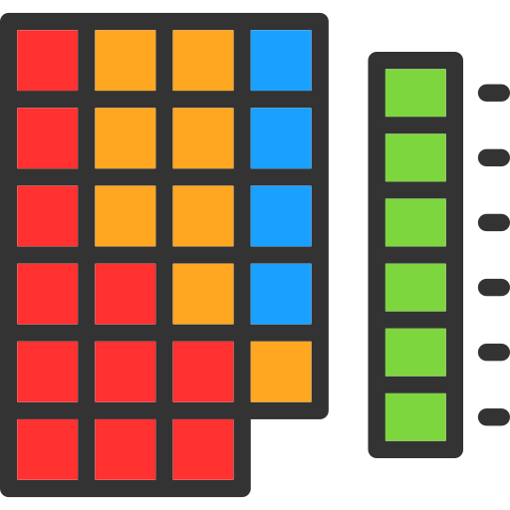
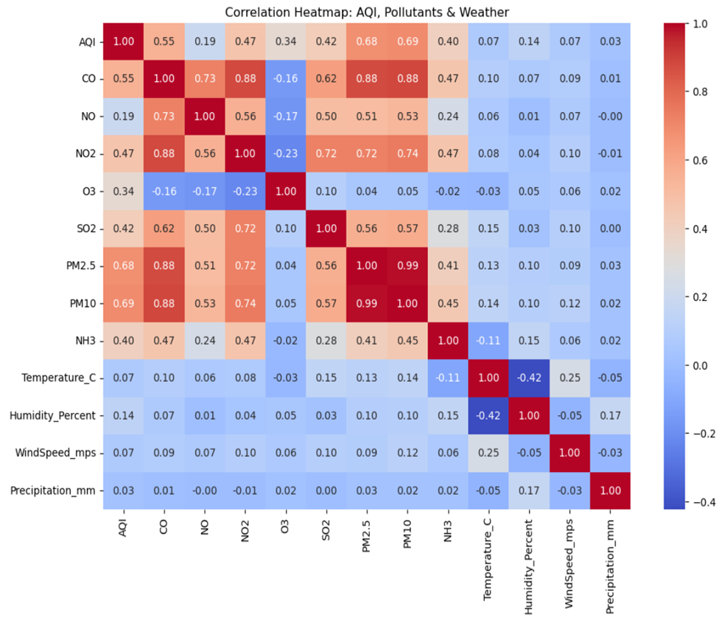
Correlation Between AQI, Pollutants & Weather
AQI is mainly driven by PM10 (0.69) and PM2.5 (0.68). Pollutants like CO, NO₂, and SO₂ are highly interrelated, while weather factors show weak influence.
AQI is strongly linked with PM10 (0.69) and PM2.5 (0.68)
High inter-correlation observed among pollutants: CO–NO₂ (0.88), PM2.5–PM10 (0.99)
Weather factors (Temperature, Humidity, Wind, Precipitation) show weak or negligible impact on AQI

Slide 19

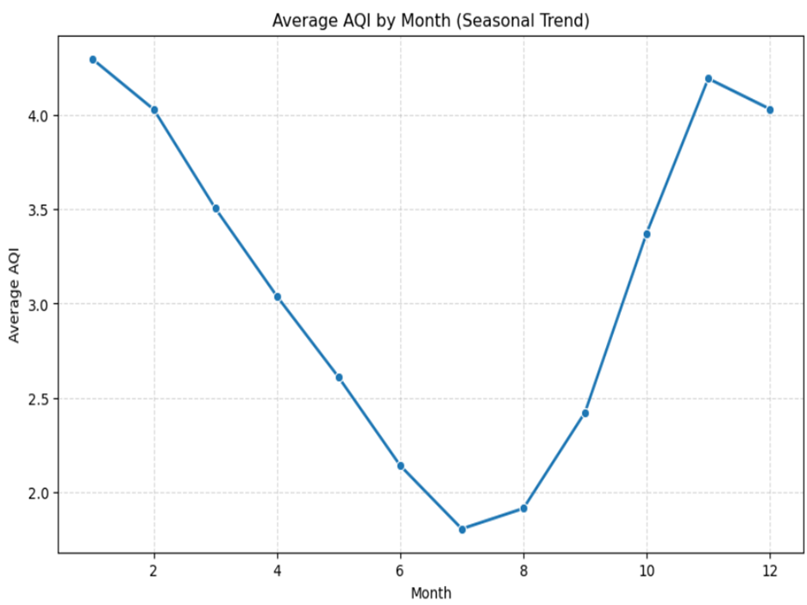
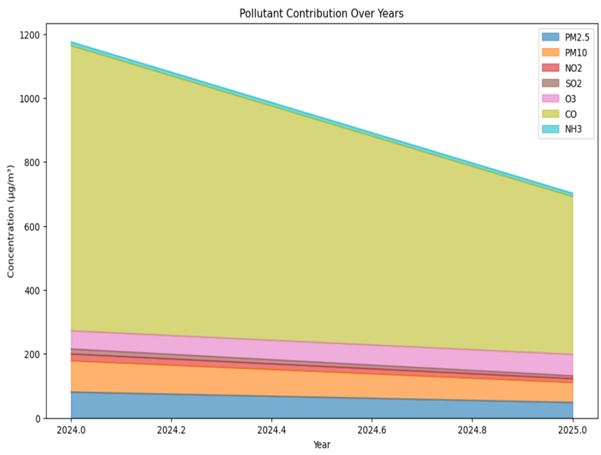
Seasonal AQI and Pollutant Trends (2024-2025)
Average AQI ranges from 4.3 in January to 1.8 in July, indicating poorer air quality in the winter months and better in summer.
CO concentration decreases from 1150 μg/m³ in 2024 to 750 μg/m³ in 2025, showing a significant reduction in overall pollutants.

Slide 20


Data Pre-Processing

Slide 21
01
Independent & Dependent Variables Split
X = df.drop("AQI_Category", axis=1)
y = df["AQI_Category"]
02
Handling Categorical Encoding
LabelEncoder, OneHotEncoder, and Ordinal Encoder were imported (suggesting use for categorical transformation if needed).
03
Scaling / Normalization
Various scalers (StandardScaler, MinMaxScaler, RobustScaler) were imported.
This indicates numerical features (pollutant concentrations) were intended to be normalized for ML algorithms.

Slide 22
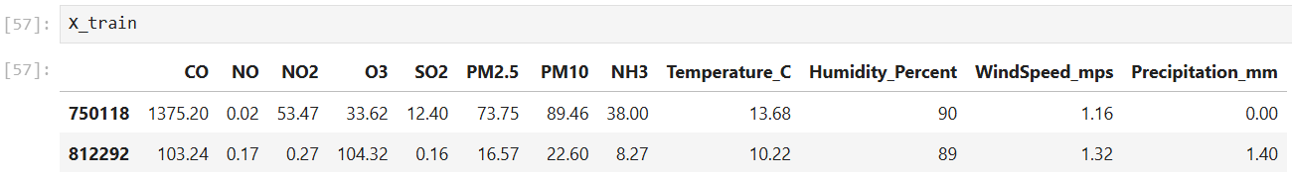
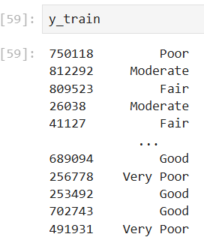
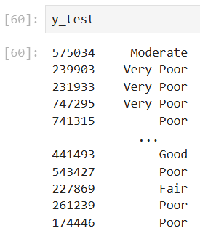
04
Train-Test Split
Data was split into training (70%) and testing (30%) using train_test_split with a fixed random state for reproducibility.

Slide 23


Model Building

Slide 24
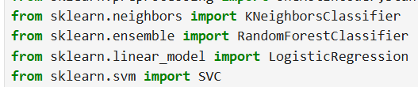

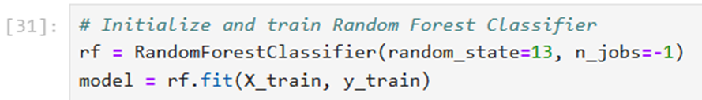
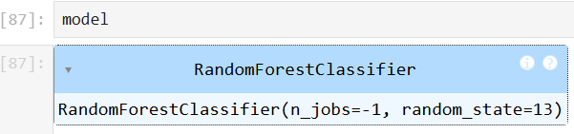
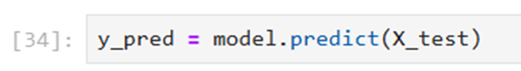
01
Imported ML Algorithm
RandomForestClassifier
02
Training the Model
Model was trained using training data (X_train, y_train).
03
Prediction
Predictions were generated on test data:

Slide 25


Model Evaluation

Slide 26

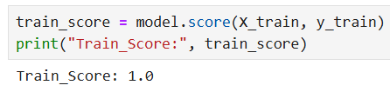
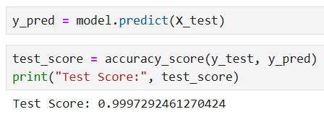
01
Train Score
Computed from the Random Forest model on the training dataset.
Indicates how well the model learned patterns from training data.
02
Test Score
Calculated using accuracy on test dataset.
Ensures the model generalizes to unseen data.

Slide 27
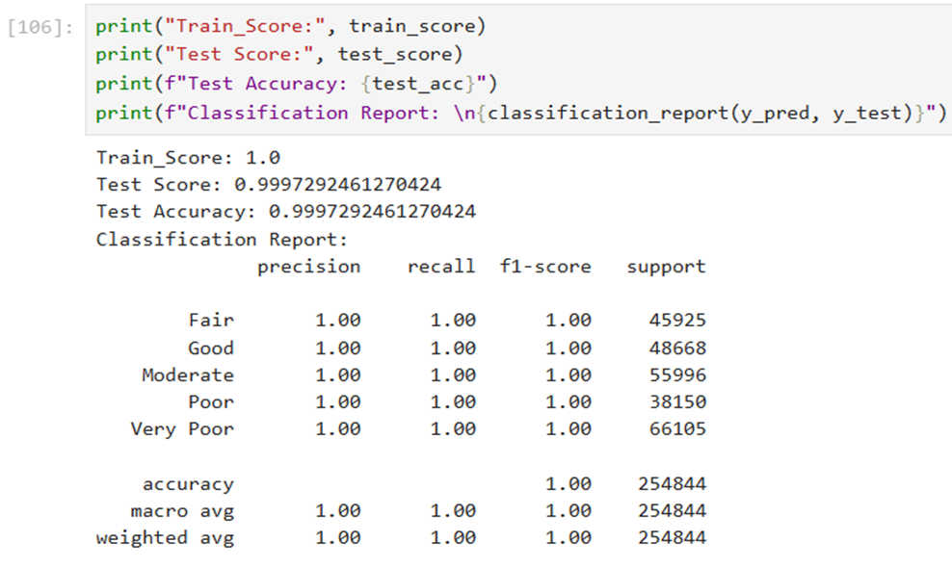

03
Classification Report
Used classification_report (Precision, Recall, F1-score) for deeper evaluation.

Slide 28


Model Deployment

Slide 29
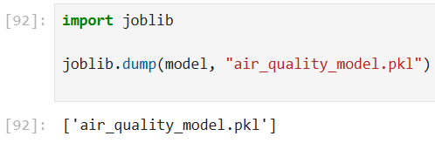
01
Export the Trained Model
Save the trained machine learning model (e.g., RandomForestClassifier) using a serialization library like joblib or pickle.
02
Set Up Deployment Environment
Prepared the production environment where the model will be hosted(i.e. Hugging Face & Streamlit Application).
Install all required dependencies (e.g., scikit-learn, pandas, numpy).

Slide 30

AQI Predictor Sreamlit Application
Scan this QR code to explore the live AQI Predictor Pro web app.

Slide 31
Any
Questions?
hello@reallygreatsite.com

Slide 32

THANK
YOU!
hello@reallygreatsite.com

